Slide 1
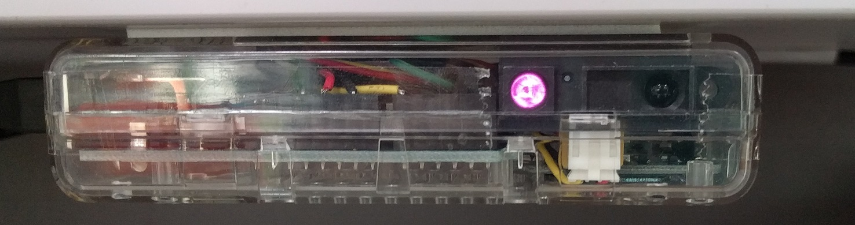
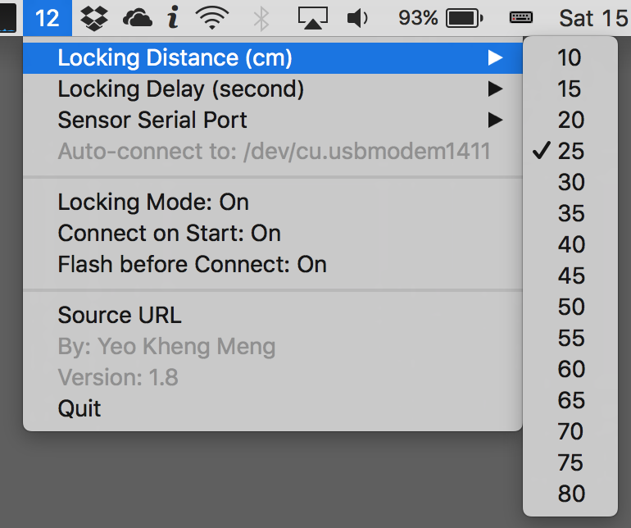
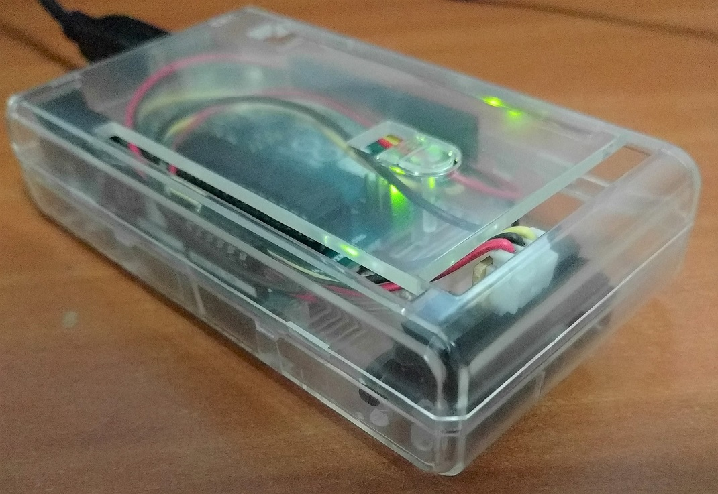
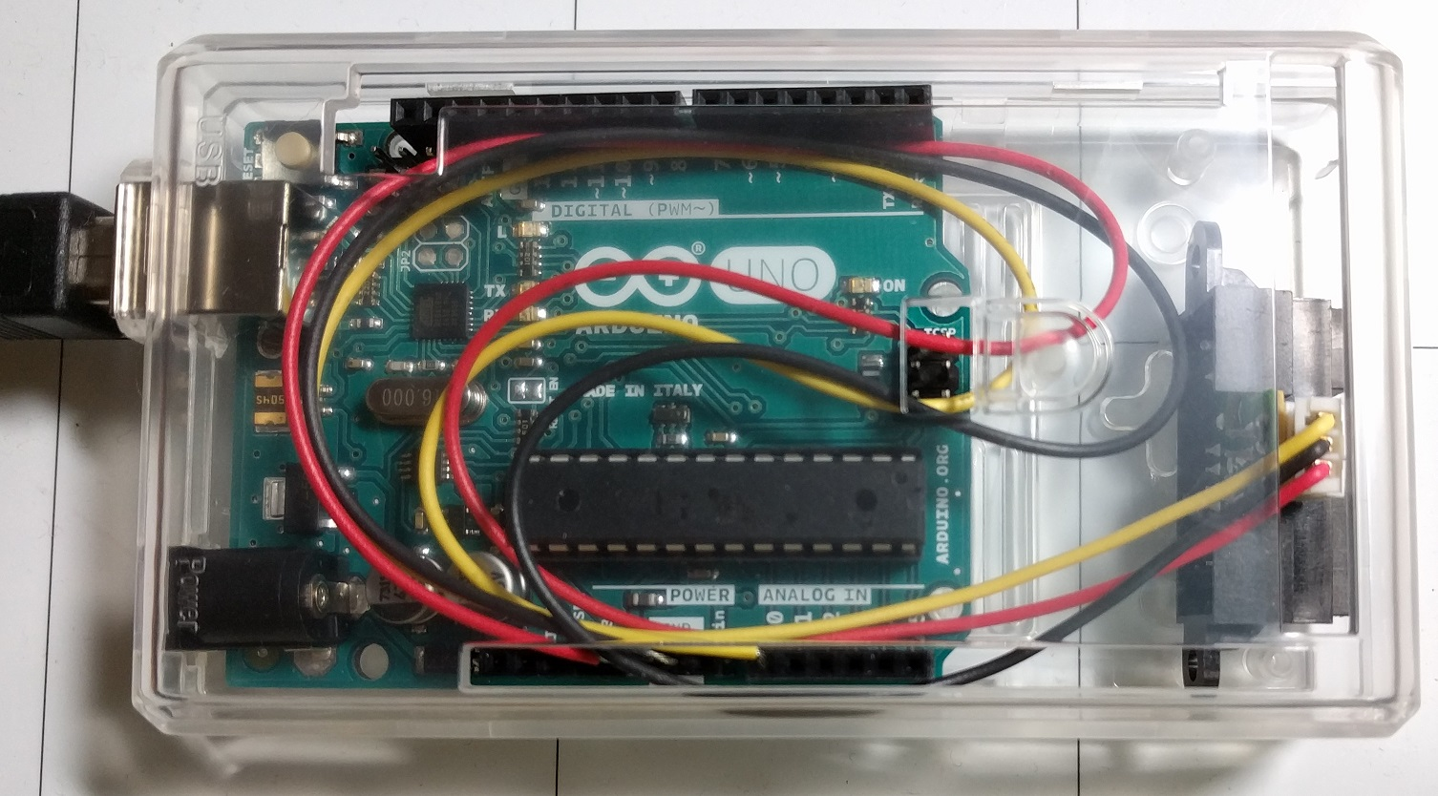
Distance Machine Locker
iOS Dev Scout (25 Apr 2017)
SP Digital Tech Talk (12 Jan 2017)
By: Yeo Kheng Meng (yeokm1@gmail.com)
and Vina Rianti (https://github.com/vinamelody)
https://github.com/yeokm1/distance-machine-locker

Slide 2
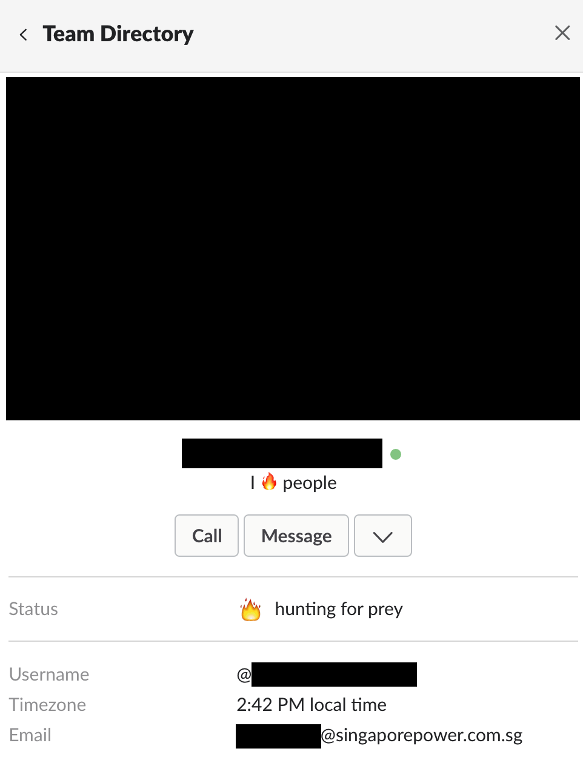



Problem?
Red Team
+ unlocked machines

Slide 3





Trail of destruction

Slide 4
Solution?
Distance-measuring system
Locks machine when I leave

Slide 5
Demo

Slide 6
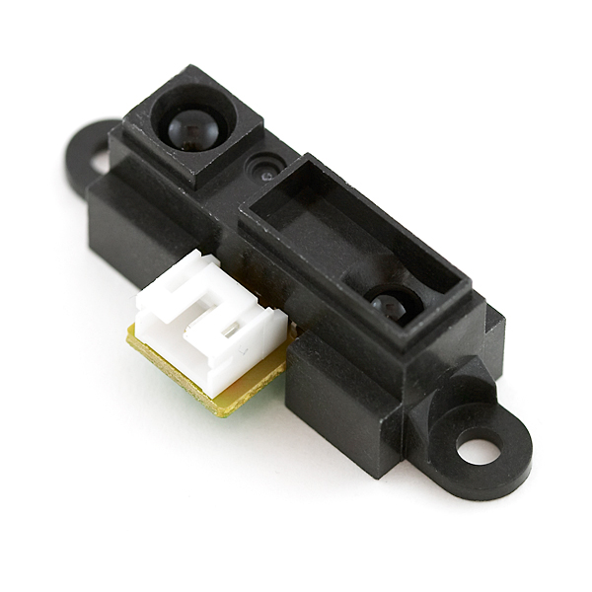
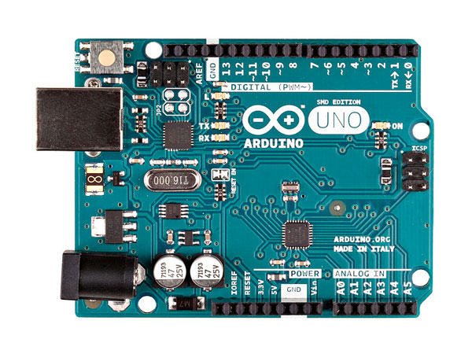
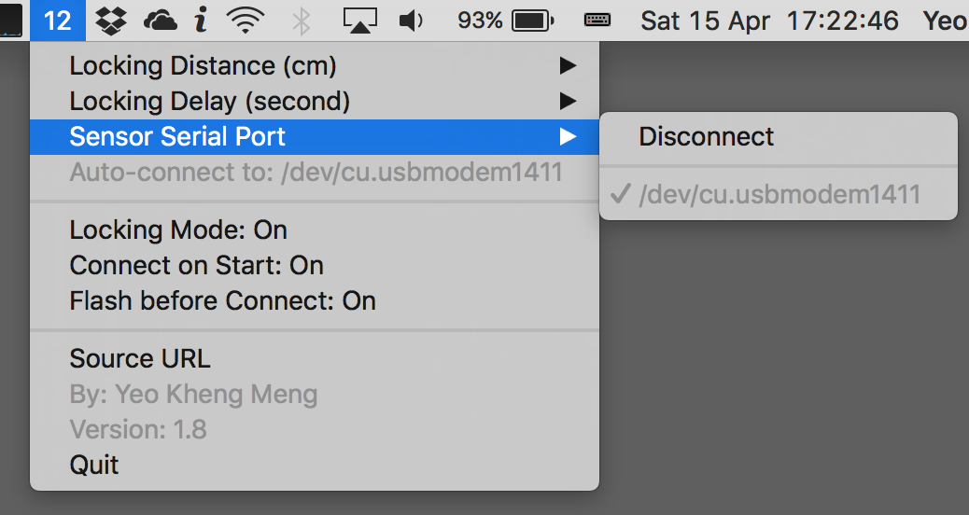
System overview
Distance Sensor
Arduino Uno
Swift Desktop app

Slide 7
Agenda
Hardware Device
Swift App
Defensive strategies
Vina’s contribution

Slide 8
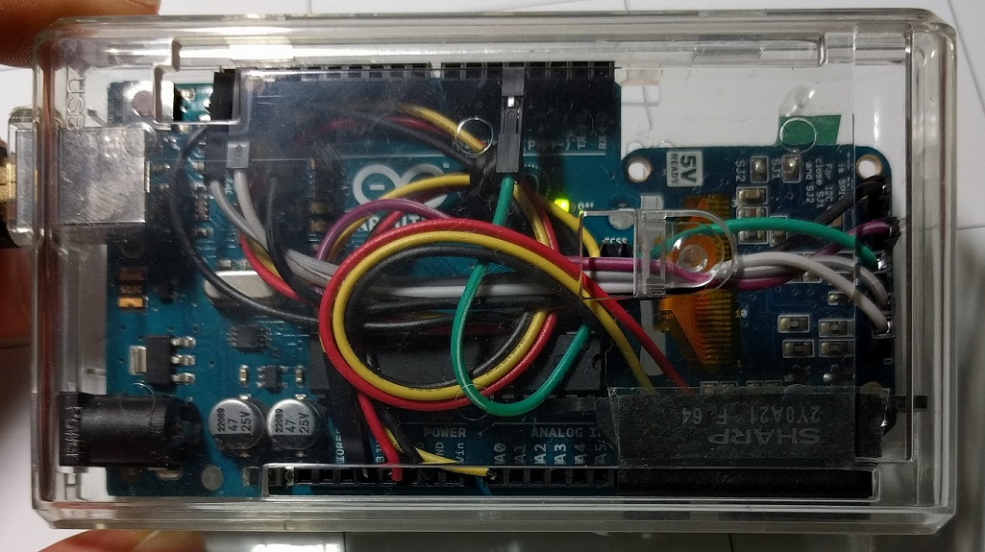
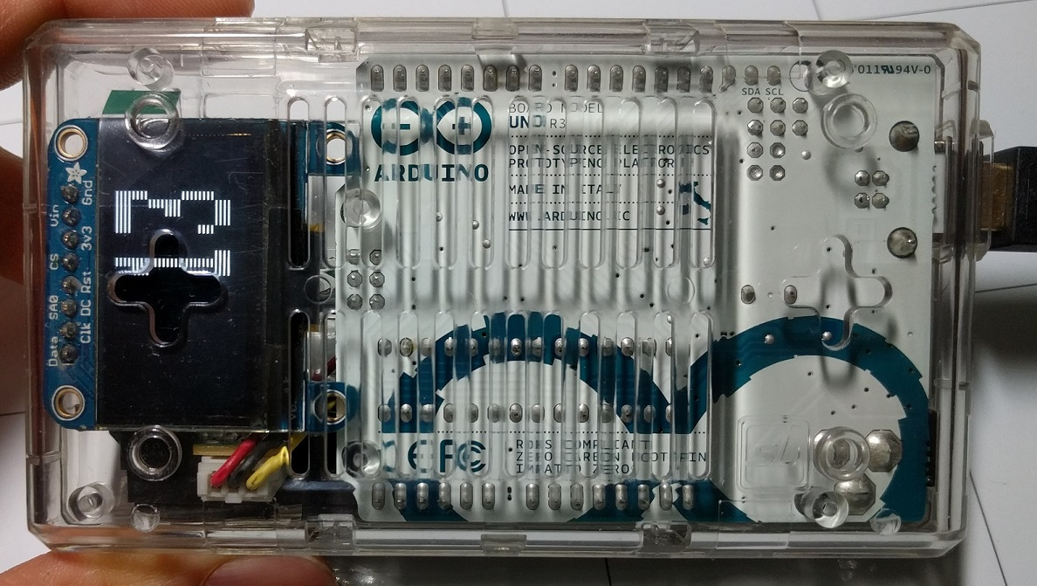
Hardware

Slide 9
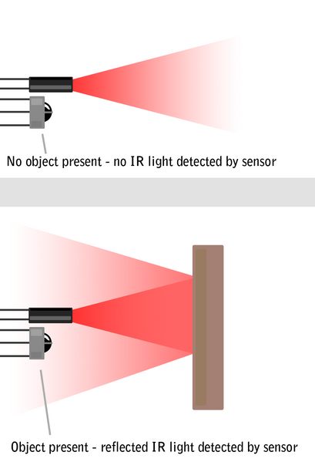

Active IR distance sensor
Active Infrared (IR) Distance Sensor
Effective range: 10 to 80cm
Source: http://education.rec.ri.cmu.edu/content/electronics/boe/ir_sensor/1.html

Slide 10
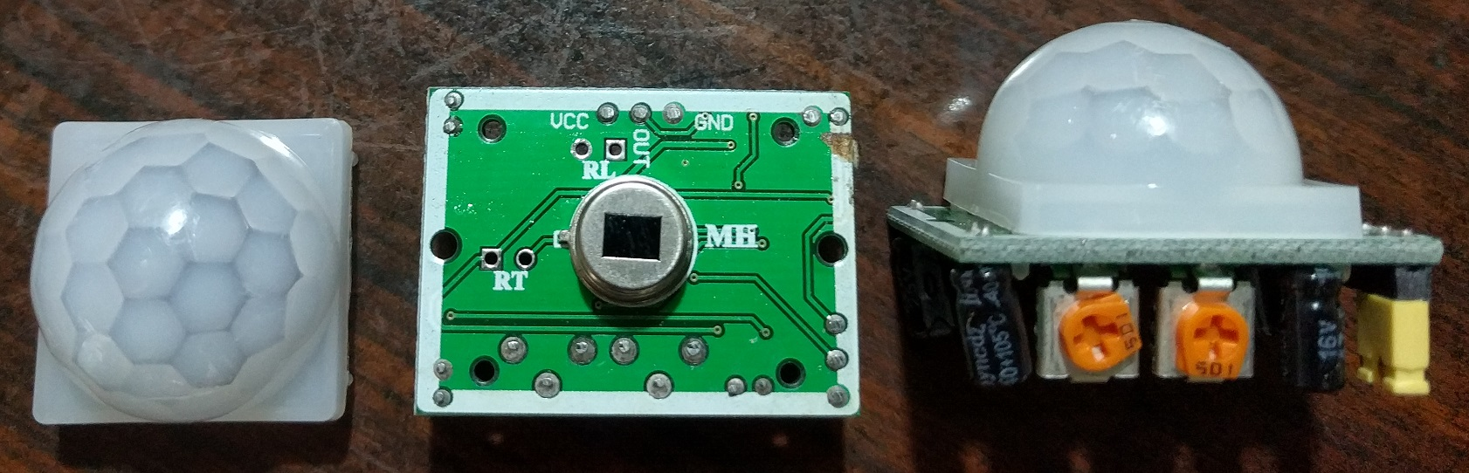
Alternative sensor 1: Passive IR
Range 7m
Can only detect presence
Higher error rate

Slide 11
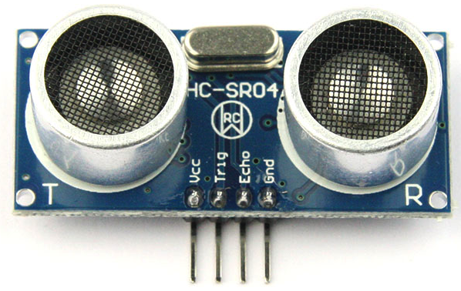
Alternative sensor 2: Ultrasonic
2cm to 4m
“Noisy” results

Slide 12
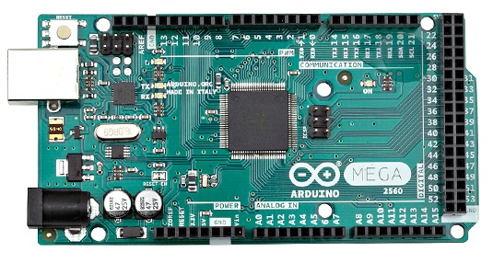
Putting them all together
Arduino Uno
Arduino Mega 2560
Arduino Uno in casing meant for Mega 2560
Mounting-hole compatible

Slide 13
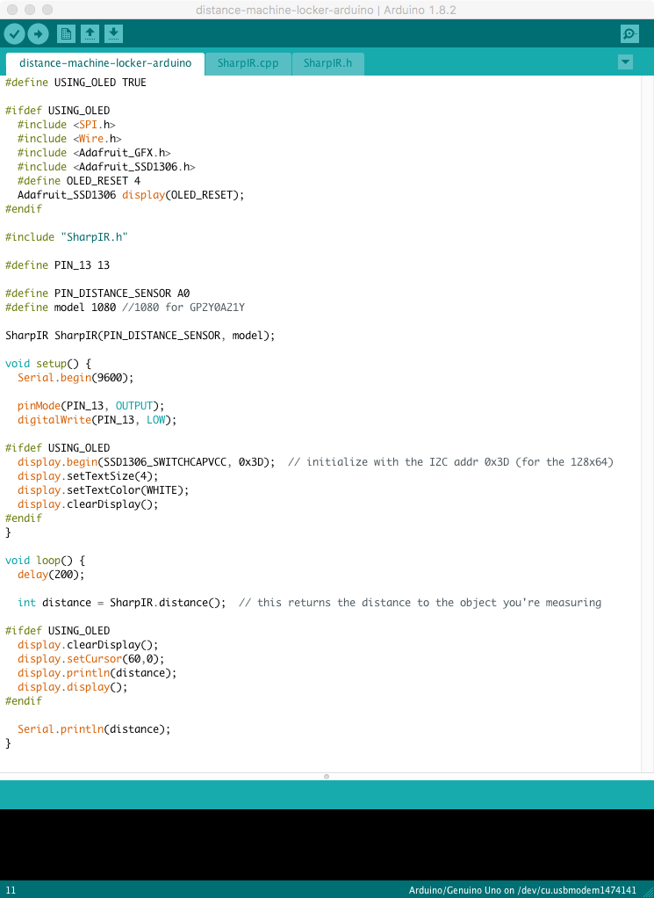
Arduino firmware
Arduino IDE
Prints cm distance via USB Serial Port

Slide 14
Host App
Distance (cm) via
USB-Serial
Swift 3 Menubar app
Receives Data from USB-Serial Port
Locks machine on threshold reached

Slide 15
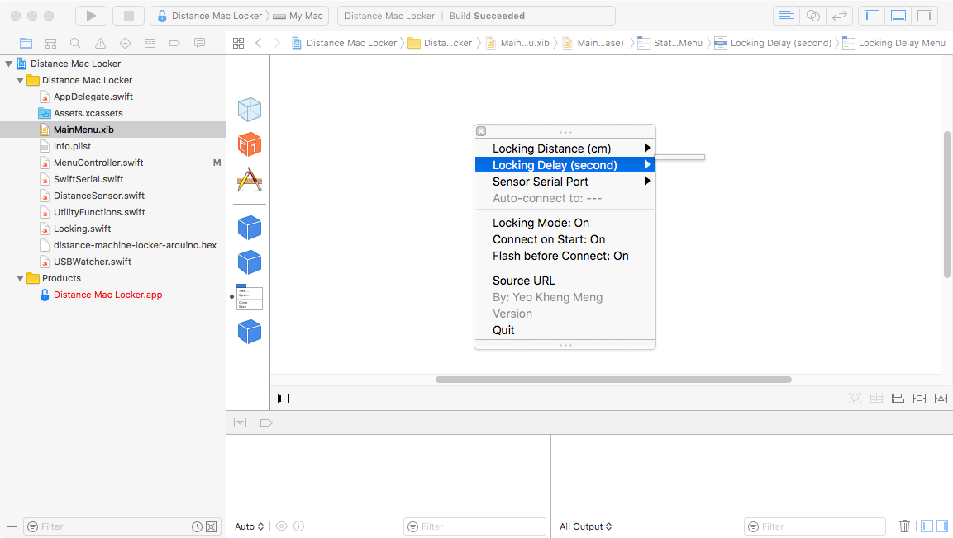
About the Menubar app
Menubar app (MainMenu.xib, MenuController.swift)
No Main Window, dock icon
No Storyboards, just a single xib

Slide 16
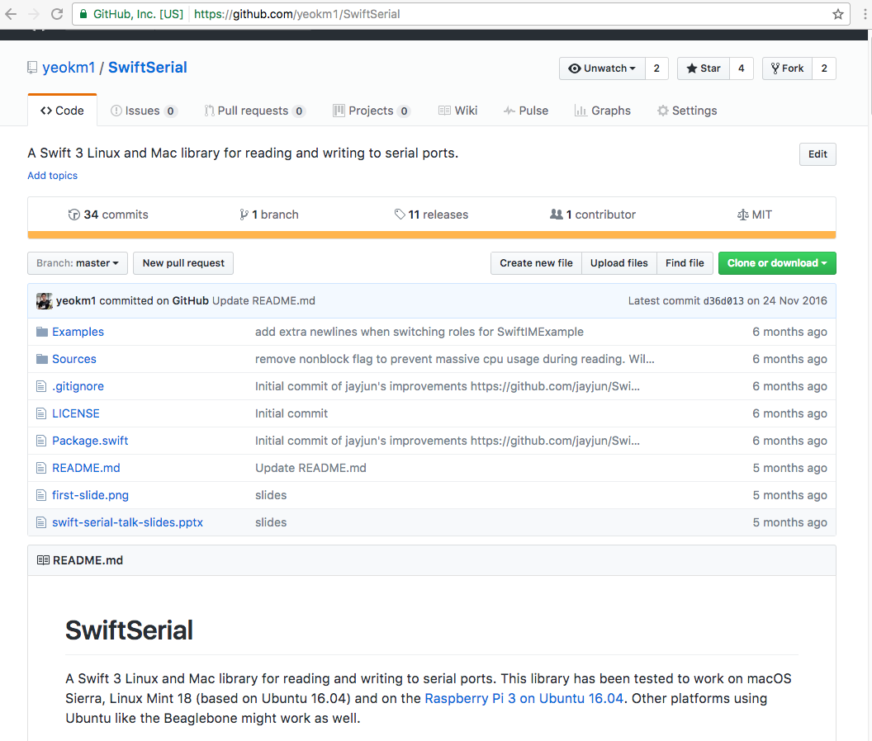
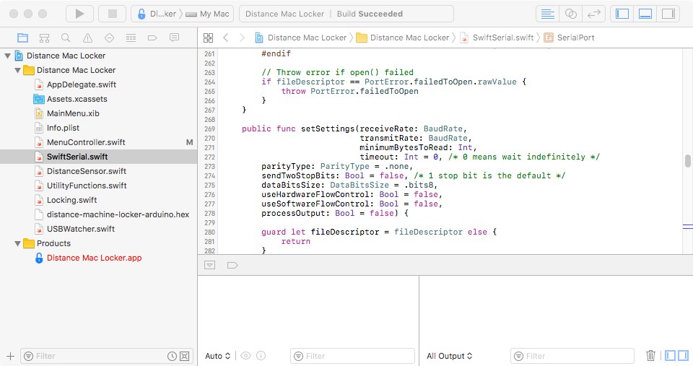
About the app: Serial Port Communication
Uses SwiftSerial library written by yours truly
https://github.com/yeokm1/SwiftSerial
https://engineers.sg/v/1275

Slide 17
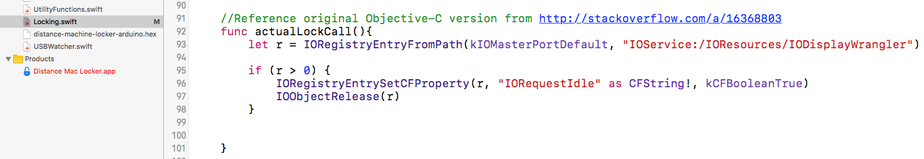
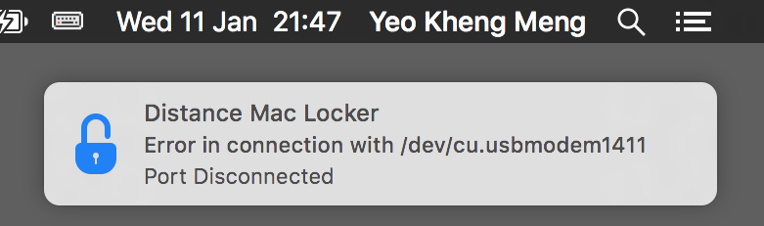
About the app: Locking
Lock screen (Locking.swift)
Use IOKit (suggested by http://stackoverflow.com/a/16368803 )
CGSession –suspend hides notification
/System/Library/CoreServices/Menu Extras/User.menu/Contents/Resources/CGSession –suspend

Slide 18
Potential Hacking and Defensive Strategies?

Slide 19
Hack 1: Disconnecting device
Defence:
Lock machine immediately
Issue system notification
Detect device disconnect: USBWatcher.swift hooks to IOKit
http://stackoverflow.com/a/41279799 (screenshot)
Auto-reconnection when device is plugged back

Slide 20
Hack 2: Tamper hardware to provide incorrect values
Defence: Vigilant monitoring of distance values on menu bar

Slide 21
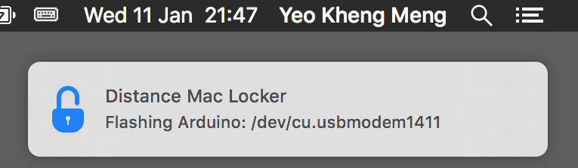
Hack 3: Reprogramming with malicious firmware
Defence: Reprogram Arduino before using it
Mac App contains hex (firmware) file exported from Arduino IDE
Flashes hex file with avrdude within Arduino.app
Mac App
Arduino.app
avrdude
firmware.hex

Slide 22
A possible “undetectable” hacking strategy
Overwrite the Arduino bootloader

Slide 23
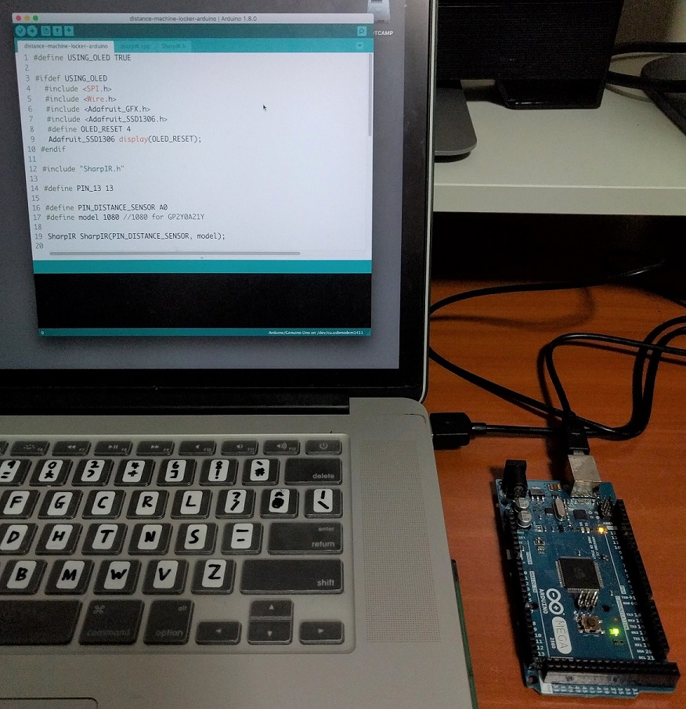
Typical Arduino Programming
Arduino IDE
USB cable

Slide 24
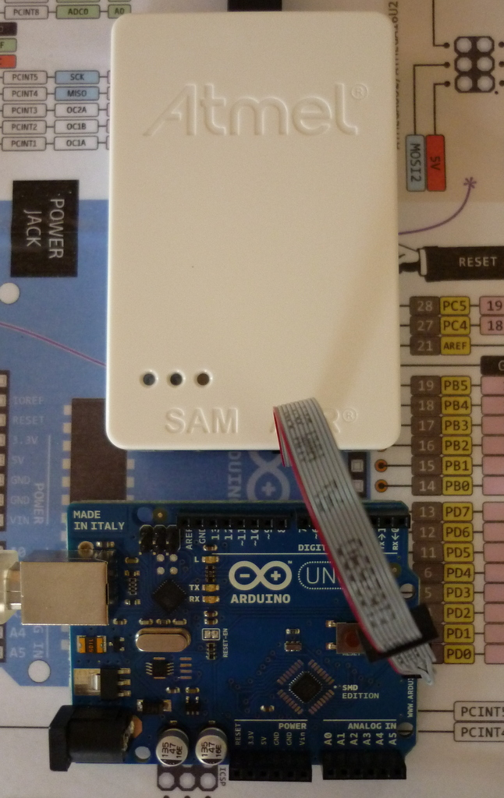
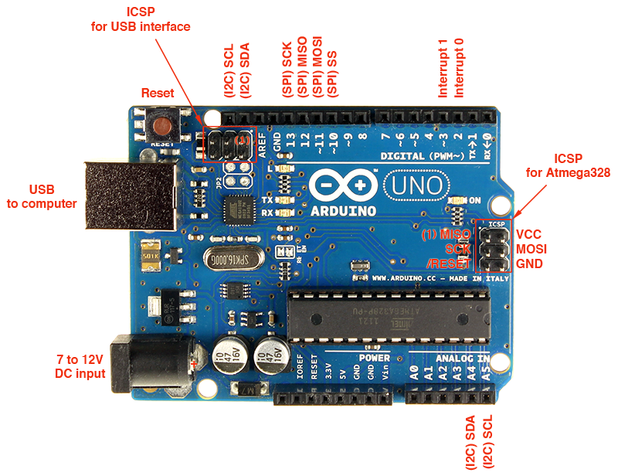

Microcontroller programming the actual way
Using dedicated programmers with ICSP port
ICSP – In-circuit system programmer
+
=
Image sources:
http://www.atmel.com/tools/atatmel-ice.aspx
http://blog.alrightythen.de/2014/08/debugging-with-the-new-atmel-ice/

Slide 25
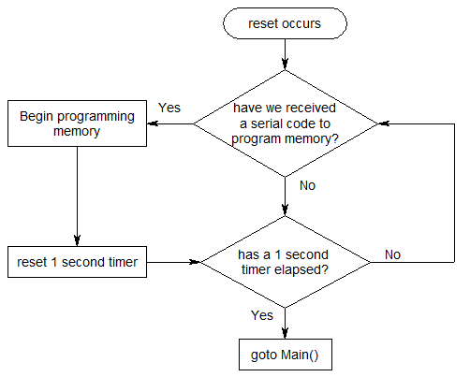
What is an Arduino bootloader?
Allows Arduino IDE to program Arduino board via USB

Slide 26
Vina Rianti

Slide 27
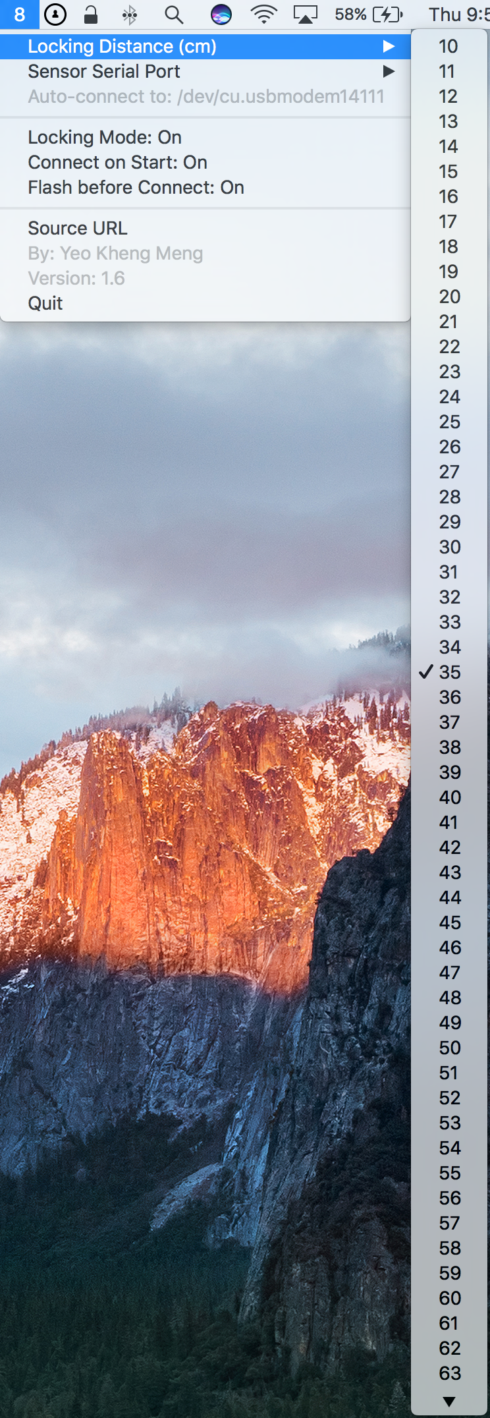
Key learnings
Experience turns into idea (or request) on how to make it better
Distance options too long (10 to 80)
Don’t lock my machine immediately

Slide 28
How to shorten the Locking Distance?
Make the option every 5 cm instead of 1 cm
for distance in DISTANCE_MINIMUM...DISTANCE_MAXIMUM {
let distanceMenuItem = NSMenuItem(title: String(distance), action: #selector(distanceMenuItemClicked), keyEquivalent: "")
distanceMenuItem.target = self
if distance == currentLockingDistance{
distanceMenuItem.state = NSOnState
}
distanceMenu.addItem(distanceMenuItem)
}
var option = 5
let DISTANCE_MINIMUM = 10
let DISTANCE_MAXIMUM = 80
for i in DISTANCE_MINIMUM...DISTANCE_MAXIMUM {
if option >= DISTANCE_MAXIMUM {
break
} else {
option += 5
}
print(option)
}
Notes:
Give Swift normal for loop example

Slide 29
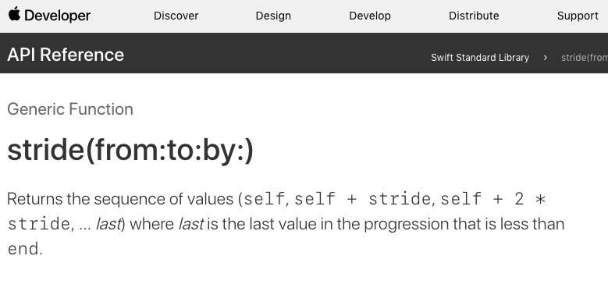
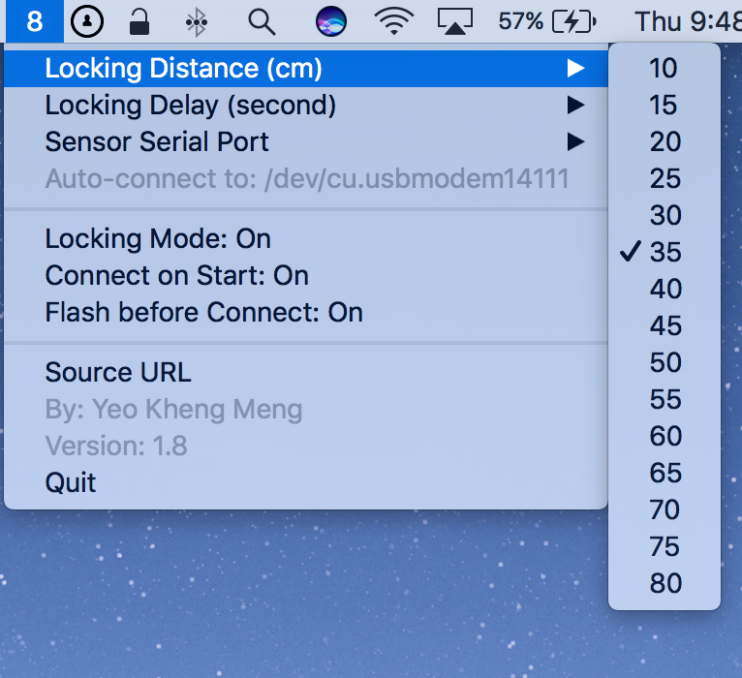
How to shorten the Locking Distance?
Can I do it more elegantly?
for distance in stride(from: DISTANCE_MINIMUM, through: DISTANCE_MAXIMUM, by: 5) {
let distanceMenuItem = NSMenuItem(title: String(distance), action: #selector(distanceMenuItemClicked), keyEquivalent: "")
distanceMenuItem.target = self
if distance == currentLockingDistance{
distanceMenuItem.state = NSOnState
}
distanceMenu.addItem(distanceMenuItem)
}
Notes:
Give Swift normal for loop example

Slide 30
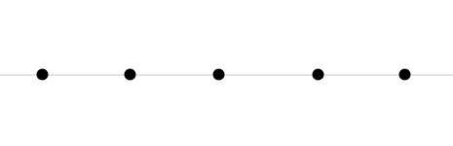
How to prevent immediate locking?
Add a Locking Delay: 0, 1, 3, 5 seconds
Example: 3 seconds delay
Out of distance
Within distance
Time
T1
Not going to lock
Out of distance
Time
T1
Current time – T1 > 3 seconds ? Lock !
Question: How does the code work?

Slide 31
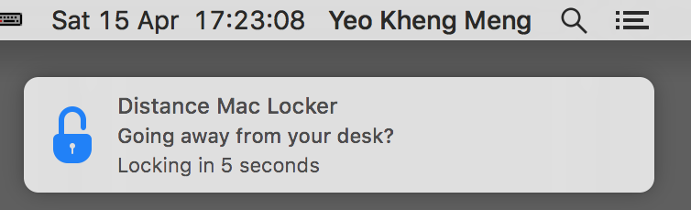
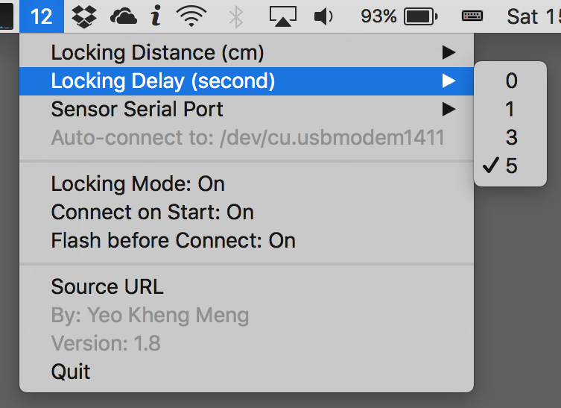
Show me the code!
func distanceReceived(distance: Int){
...
if lockingMode && distance >= currentLockingDistance {
if goingToLock == false {
goingToLock = true
startLockingWindow(start: true)
} else {
startLockingWindow(start: false)
}
} else {
goingToLock = false
}
}
func startLockingWindow(start: Bool) {
if start {
launchLockWindow = CFAbsoluteTimeGetCurrent()
} else {
let elapsed = CFAbsoluteTimeGetCurrent() - launchLockWindow
if elapsed >= Double(lockingTimeout) {
locking.lockMachine()
}
}
}

Slide 32
Hackers always win
Any Questions?
No physical security -> No security
https://github.com/yeokm1/distance-machine-locker

